Slide 1

Security Seals & Printing
Information Security
Chapter 14
Security Engineering by Ross Anderson

Slide 2
Group Members
Zeeshan Ali
20i-2465
Ans Zeeshan
20i-0543
Hammad Aslam
20i-1777

Slide 3
TABLE OF CONTENTS
01
02
03
04
05
Introduction
Techniques
Vulnerabilities
Packaging & Seals
Issues

Slide 4

01
Introduction
Usability of security & History

Slide 5
History & Security Printing
Need to study about more closely what causes a person to recognize forged note.
Kind of like the HCI of preventing forgeries
Security usability

Slide 6



Threat Model
Primary Level Inspection
Secondary Level Inspection
Tertiary
Level Inspection

Slide 7

02
Techniques
To Utilize traditional security documents of printing processes

Slide 8


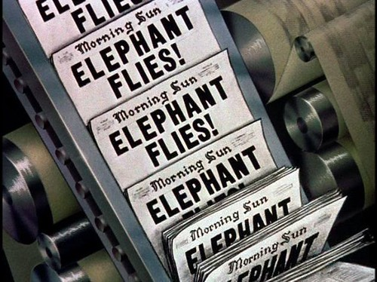

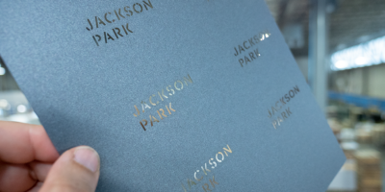
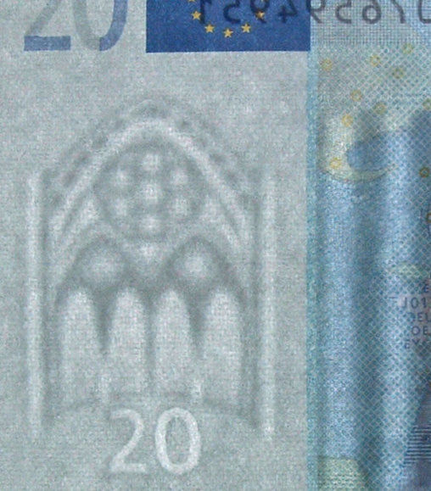
Techniques
Intaglio
Letter press
Simultan presses
Rubber stamps
Embossing and Laminates
Watermarks

Slide 9
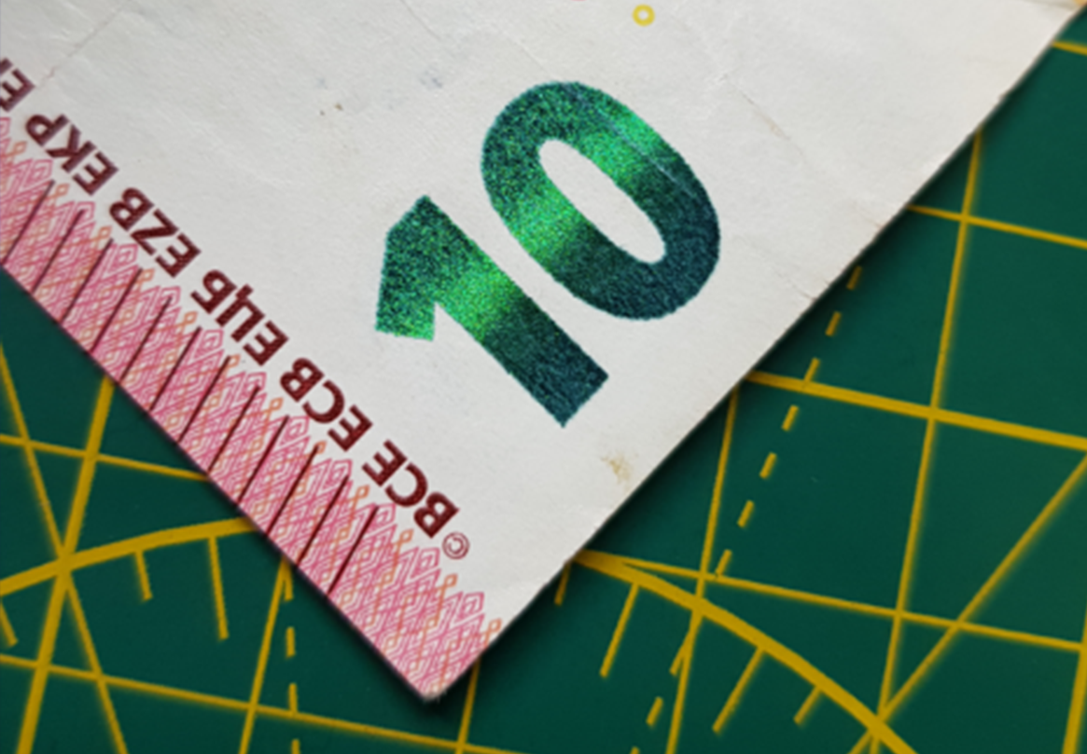
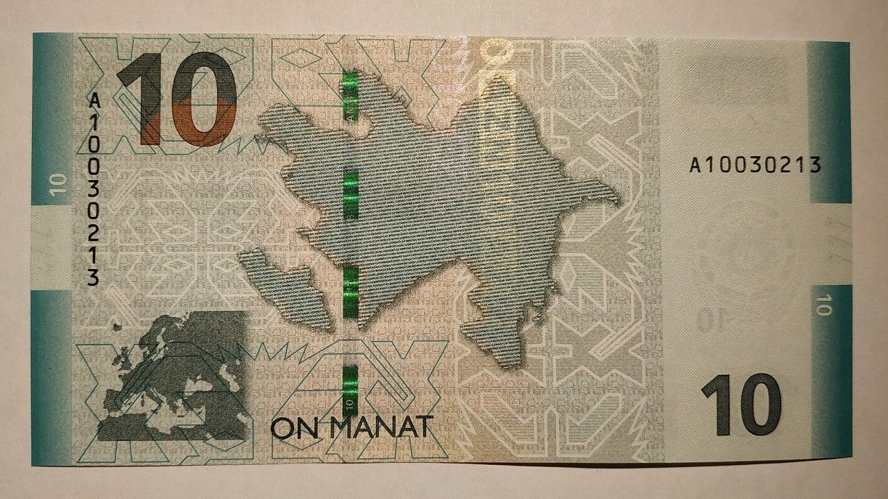


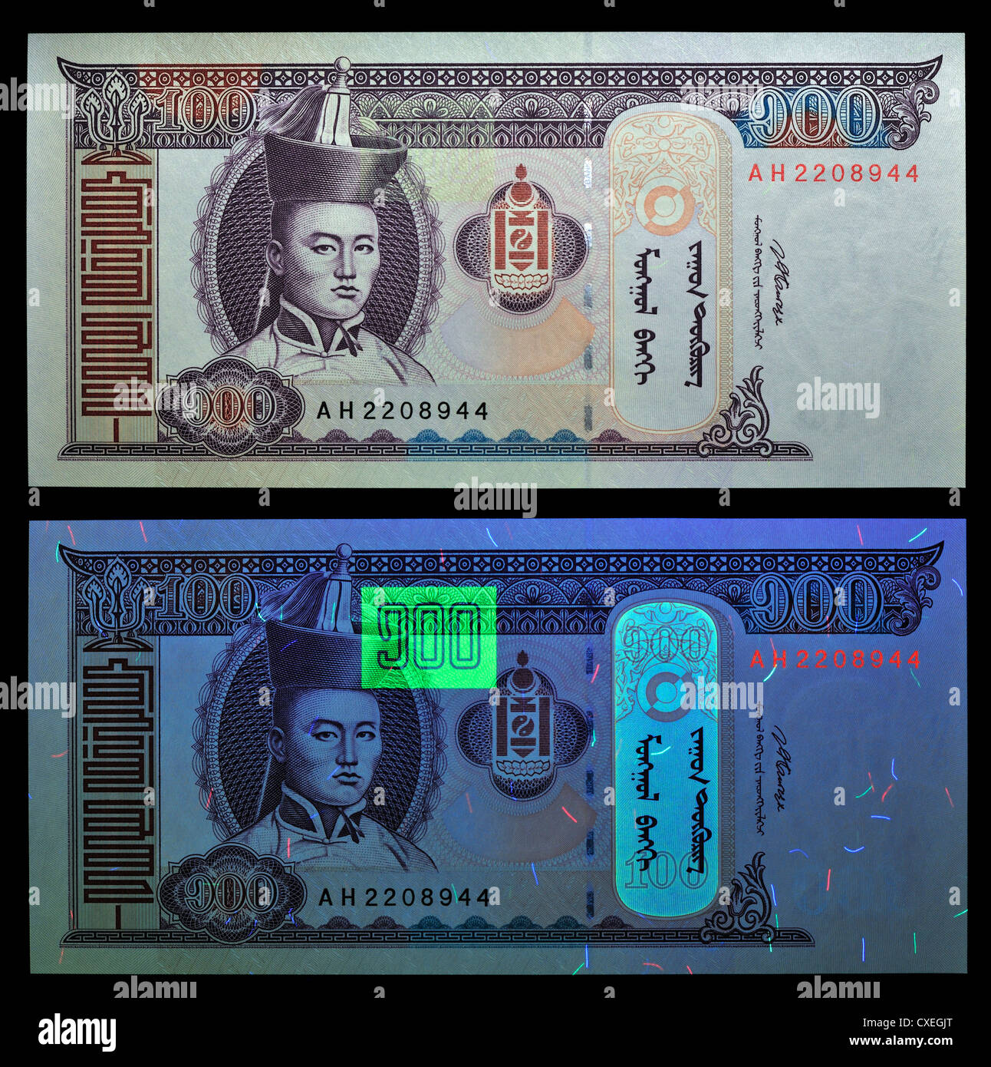

Modern Techniques
Optically Variable ink
Inks with magnetic, photo
chromic or thermochromics
Metals thread and Foils
Screen Traps
Digital copyright marks
Unique Stock

Slide 10
Technology moves Forward
What is expensive and difficult to do today but will not be tomorrow ?
Copying Big Issue | Check Fraud
Alteration | Credit cards & Travel Documents

Slide 11

Question
Which techniques are used to protect new US currency especially tactics to spot forgeries at first level inspection
1- watermarks
2- color-shifting ink
3- Ultraviolet light
4- Counterfeit detection pens
5- Magnifying glasses

Slide 12

03
Packaging & Seals

Slide 13
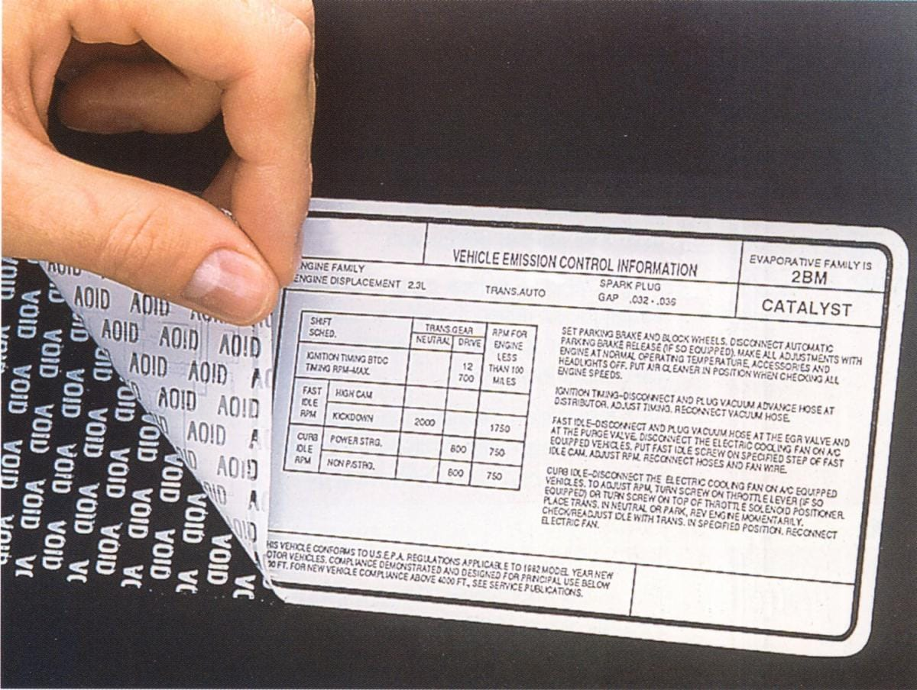
Packaging
Substrate Properties
Print on substrate glue to package
Can use the properties of the substrate to mark and make unique.

Slide 14
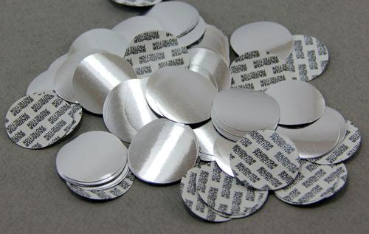
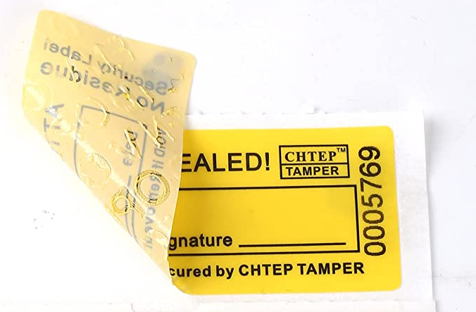
Seals
Problems of Glue
Cut the glue and remove the seal intact.
use of glue is stronger than seal substrate.

Slide 15
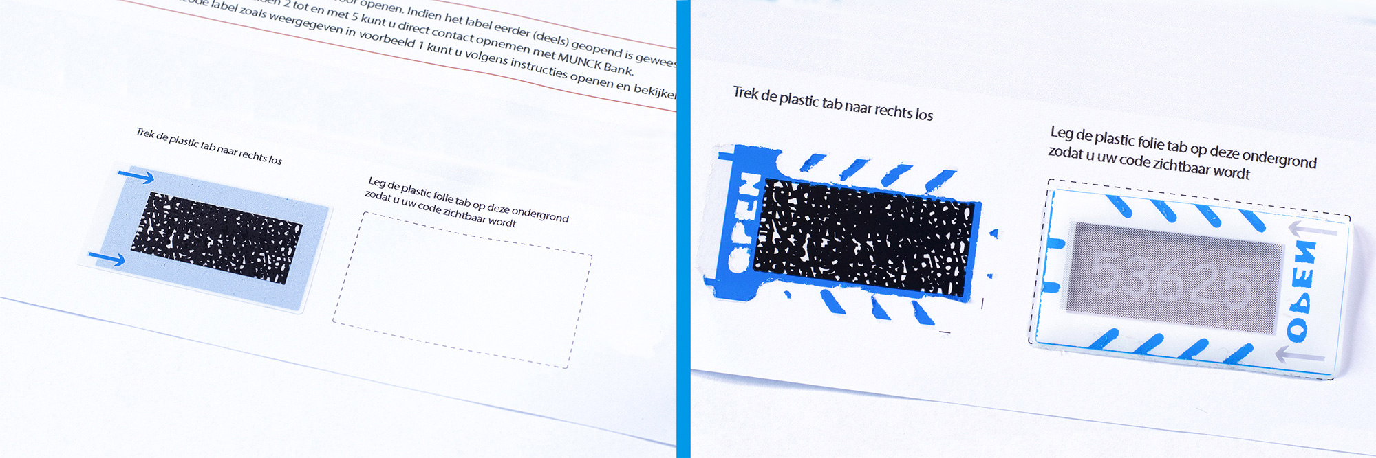
Pin Mailers
A “PIN” is a security code that belongs to you. PIN stands for personal identification number. It is delivered in temper proof envelope to maintain security and confidentiality issued by admin or an organization.

Slide 16

04
Systemic Vulnerabilities

Slide 17
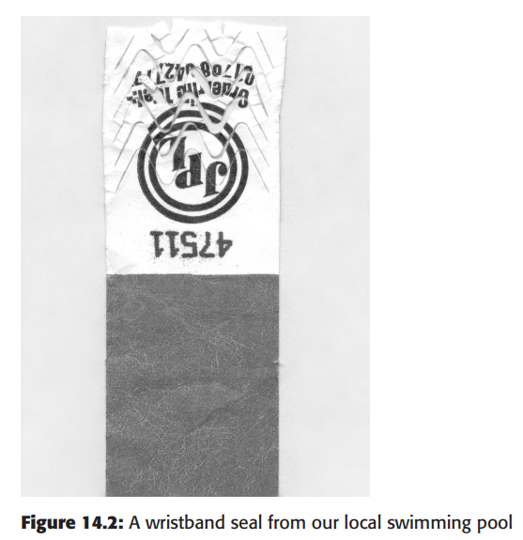
Systemic Vulnerabilities
 | Wristband Seal
01 | Enemy is customer
02 | Customer applies seal
03 | Avaliable in marketplace
04 | Inspection is Infeasible
05 | Counterfeit seals can be manufacture
06 | Seal re-use indistinguishable from failure

Slide 18
05
Issues

Slide 19
Issues
Peculiarities of the Threat Model
Material controls
Staff diligence
Cost and Nature of Inspection
Random Failure
Not protecting the right thing

Slide 20

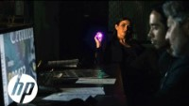

Video

Slide 21
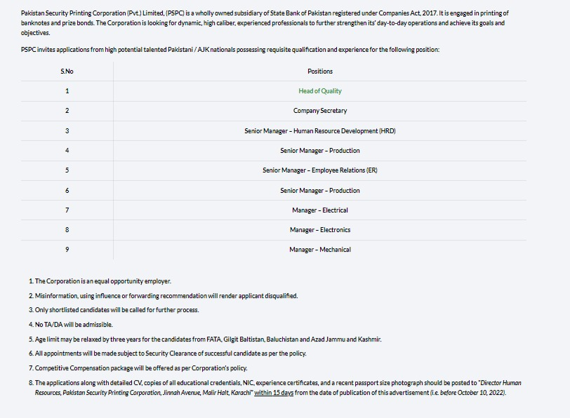




Announcement
Pakistan Security Printing Corporation
https://www.pspc.gov.pk/

Slide 22

THANKS !
Do you have any questions?
zaah.infosec@gmail.com
+92 310 704 8506
Zaah-Infosec.com

